Slide 1
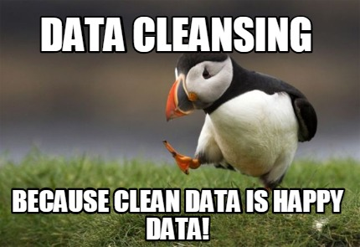
Source

Slide 2
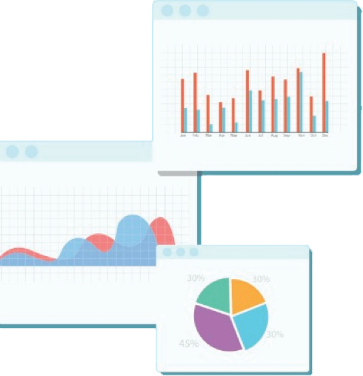


Welcome to Week 2
Lecture 2!
Data Science in Python &
Machine Learning

Slide 3
Week 2 CORE Assignments
These MUST be submitted by Sunday February 6th:
Loading & Filtering Data
Titanic Data
Project 1 - Part 2

Slide 4
Resources of Note on the LP
Making Data Tidy (optional assignment):
The optional assignment is hard and I recommended skipping it.
BUT there is an awesome Pydata Pandas cheat sheet linked at the bottom!
Prep For Belt Exam Section
Between Week 2 and Week 3 is the mock belt exam.
After this week’s assignments, you should know how to tackle part 1 of 2!
We will go over the mock belt exam in code reviews next week.

Slide 5
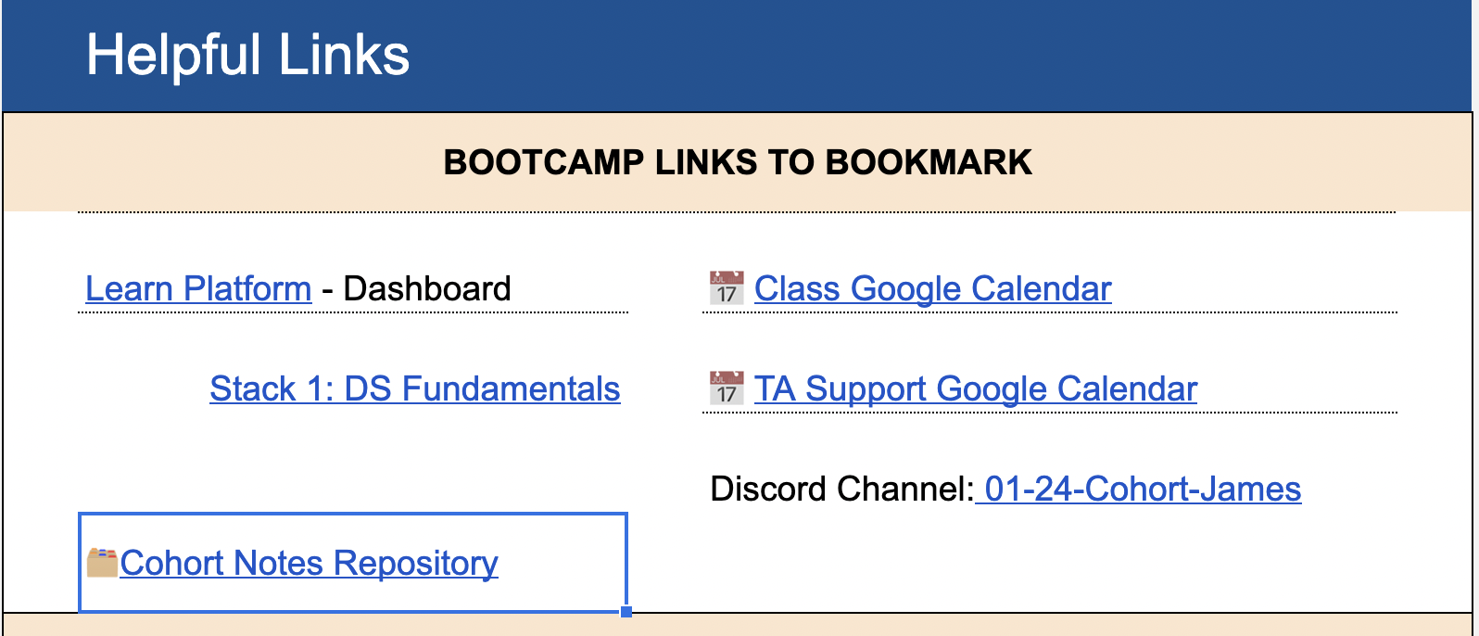
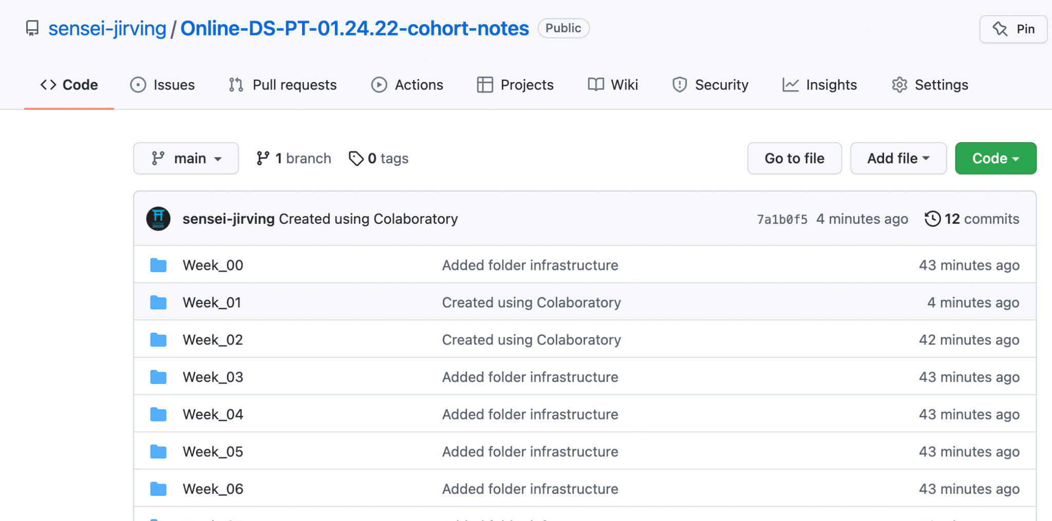
Resources of Note: Cohort Notes Repo
New Cohort Notes Repository [Link] (Link is also on Helpful Links sheet)
Same content as class, just organized into week/lecture folders.

Slide 6
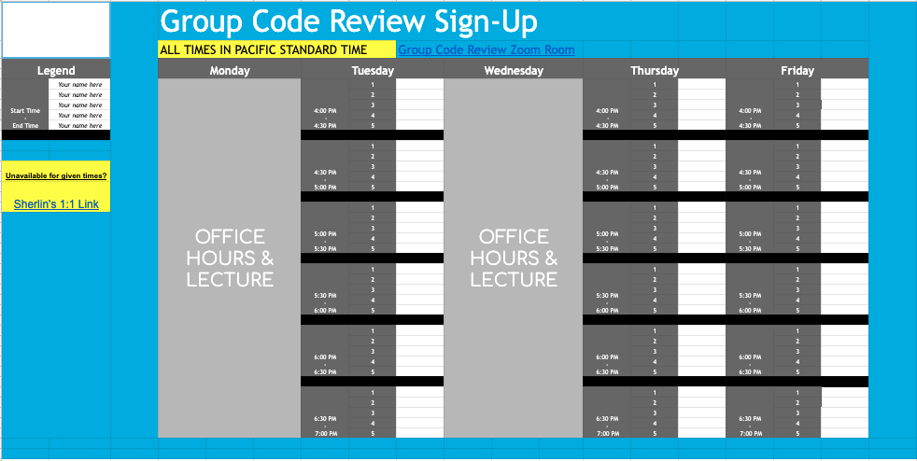
Code Reviews Next Week - Mock Belt Exam

Slide 7
Learning Goals:
By the end of this class you will be able to:
Identify the types of data cleanliness issues to fix.
Find and remove irrelevant columns
Find and drop duplicated rows
Find and correct badly-formatted/obviously-incorrect data.
Quantify missing data and select from a variety of strategies to fill or remove it.

Slide 8
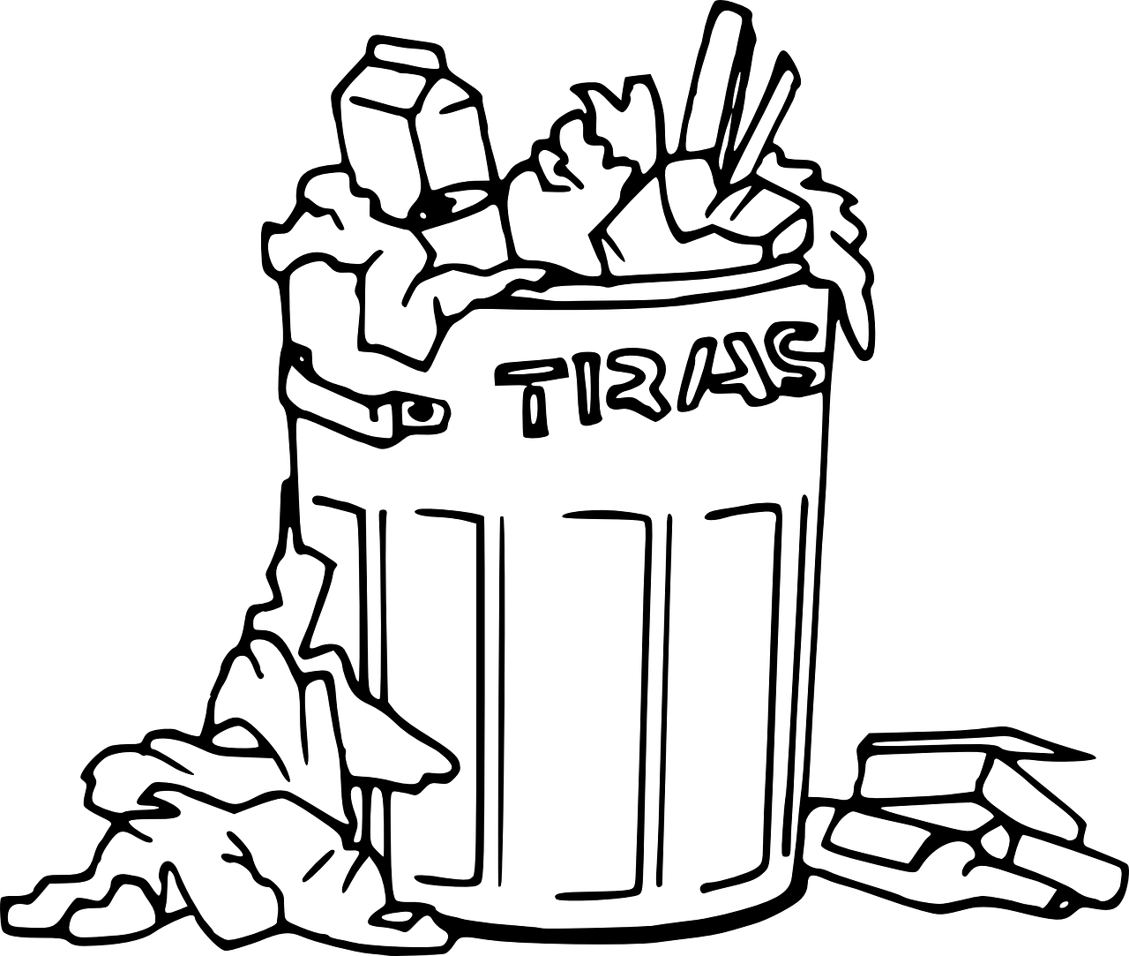
Why do we need to clean our data?
The Best Machine Learning Algorithms
Garbage in, garbage out.

Slide 9
When do we need to clean our data?
Always!
~ 80% of any data science project is data cleaning!

Slide 10
Data Issues to Address/Clean
Duplicate data
Irrelevant data
Incorrect data types
Inconsistent Values
Syntax/Spelling Errors

Slide 11
Duplicate data
Duplicate rows should be removed.
Height | Age | Phone Number
70 | 31 | (123)456-7890
72 | 45 | (098)765-4321
73 | 40 | (555)123-4567
72 | 45 | (098)765-4321

Slide 12
Irrelevant data
We want to remove data if it is unnecessary or unrelated to our task.
When in doubt, consult a subject matter expert (SME).
Height | Age | Phone Number
70 | 31 | (123)456-7890
72 | 45 | (098)765-4321
73 | 40 | (555)123-4567
71 | 42 | (222)222-2222

Slide 13
Examples of Irrelevant data
Columns with values that are unique in every row (you could consider using this as an index)
Columns with values that are all identical
An Unnamed: 0 column
Other columns that are just unnecessary for your task

Slide 14
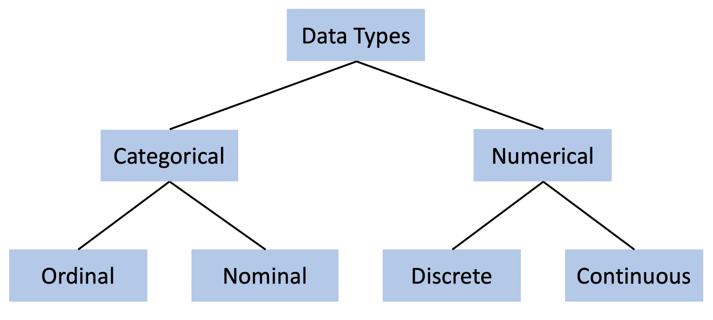
Data Types
Image Source: https://bookdown.org/ejvanholm/Textbook/displaying-data.html

Slide 15
Example of a numeric and/or a categorical variable in data science?
Numerical Type in chat or annotate here: Categorical

Slide 16
Incorrect Data types
An unexpected data type could be a clue to bad data!
Numerical data should be an int or float
Be careful, numbers can represent categories

Slide 17
Data types
These are just categories, NOT numeric values
Height | Age | Homeowner
70 | 31 | 0
72 | 45 | 1
73 | 40 | 1
72 | 45 | 0

Slide 18
Data types
If even one value is typed in as a string, the column will NOT be recognized as numbers
Height | Age | Homeowner
70 | 31 | 0
72 | 45 | 1
73 | forty | 1
72 | 45 | 0
You can correct this manually by using:
df.loc[2, ‘Age’] = 40

Slide 19
Unit inconsistencies
If measurements are in different units (for example, km vs. miles) we should ensure consistency in the data.

Slide 20
Unit inconsistencies
Height | Age | Pet
70 | 31 | cat
73 | 40 | dog
6 | 43 | dog
68 | 32 | dog
Is the person really only 6 inches tall?
Is it completely invalid data?
Is it possible the data was entered in the wrong unit?
Data cleaning requires judgement calls which can be very frustrating!!

Slide 21
Formatting and Syntax

Slide 22
Categorical Data
Height | Age | Pet
70 | 31 | Cat
72 | 45 | cat
73 | 40 | dog
72 | 45 | Dogs
68 | 32 | dogg
71 | 35 | cat
We want TWO category options for pet (either cat or dog).
How many categories does this data table show?

Slide 23
Common Syntax or spelling errors
Upper and lowercase letters
Plural forms
Spelling errors or typos
Abbreviations
Extra white spaces at the beginning or end of strings or column names.

Slide 24
Outliers
Too big? Too Small? Seems unlikely?

Slide 25
Outliers
Outliers are values that are extremely higher or lower than all of the other values in that feature.
If you see outliers in your data, it might be due to unit inconsistencies (check first)
In general, outliers should not be removed unless you have reason to believe it is an error in the dataset.

Slide 26
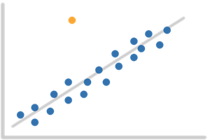
Outliers: Unusual values
If your dataset is small enough, outliers can be identified by just eyeballing the value.
2.1, 3.7, 1.5, 3.0, 156.1, 2.6, 1.9
For larger datasets, visualizations are a quick way to spot outliers.
We will learn data visualization next week!

Slide 27

Missing Data
Always Fix Missing Data!!

Slide 28
Missing Data
Height | Age | Pet
70 | 31 | cat
73 | 40 | dog
72 | NaN | dog
68 | 32 | NaN
Why is the value missing?
Are there any patterns in missing data?
Does a missing value under Pet simply mean “no pet”?
Was pet left blank because the person has a turtle which wasn’t a choice?
Data cleaning requires judgement calls which can be very frustrating!!

Slide 29
Missing Data
Missing values are very common and problematic in our data. There is no one right way to handle missing data. A few strategies include:
Drop rows
Drop columns
Impute values

Slide 30
Dropping Missing Data
If there are not very many missing values and they are missing completely at random, the easiest solution is to drop the rows or columns with missing values.
A good rule of thumb is to limit dropped data to 5%

Slide 31
Imputing Missing Data
Imputing means filling in the missing values based on some criterion. There are many methods to do this:
Simple imputation including mean, median, or mode imputation
More Advanced Imputation: Using a predictive model to impute the values

Slide 32
Imputing Missing Data
Height | Age | Pet
70 | 31 | cat
73 | 40 | dog
72 | NaN | dog
68 | 32 | cat
If using mean, the missing value would be replaced with 34 (or 34.3)

Slide 33
Imputing Missing Data
NOTE about imputation:
The Learn Platform curriculum introduces ‘ffill’, ‘bfill’, and ‘linear’ methods of imputing using df.fillna().
Only consider this if the data is ordered in some way and those make sense. One example might be if each row is a date or time and they are organized chronologically.
Generally use ‘median’, ‘mean’, ‘mode’, or a constant value depending on the circumstances.

Slide 34
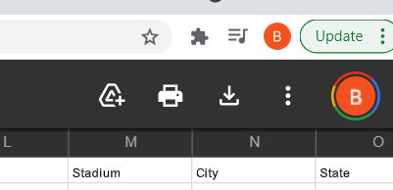
YOur turn!
Data:
Here is the dataset you will be working with:
Superbowl data set
Notebook:
Go to this link and make a copy!
Colab Notebook
Happy Coding!
Open the link and then add the shortcut to your drive (or download/upload)

Slide 35
How-To Slides
Python Reference

Slide 36
Dropping a Column
An entire column can be dropped using:
df.drop(columns = ‘Phone Number’, inplace = True)
OR
df = df.drop(columns = ‘Phone Number’)

Slide 37
Dropping Multiple Columns
df.drop(columns = [‘Phone Number’,‘Unnamed: 0’], inplace = True)
OR
df = df.drop(columns = [‘Phone Number’, ‘Unnamed:0’])
List the names of columns to drop in square brackets

Slide 38
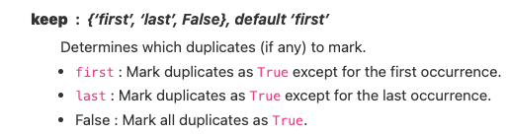
Check for any duplicated data in Python using: df.duplicated().any()
Check to see which data is duplicated: df[df.duplicated(keep = False)]
Drop duplicates in Python using: df.drop_duplicates(inplace = True)
Duplicate data: in Python
A Filter!

Slide 39
Data types: in Python
Check data types in Python using:
df.dtypes
Or:
df.info()
If there is a data dictionary, you can validate your data types with that! Otherwise, use your best judgement.

Slide 40
Syntax or spelling errors: in Python
Check for counts of each categories using:
df[‘column’].value_counts()
And look for any values that look weird/should be interpreted as the same things!

Slide 41
Replace Incorrect Data
As a list
df.replace([‘dogg’, ‘Dogs’], [‘dog’, ‘dog’], inplace = True)
As a dictionary
df.replace({‘dogg’: ‘dog’, ‘Dogs’, ‘dog’}, inplace = True)

Slide 42
Identifying Missing Data
df.info() Tells the number of values in each column
df.isna().sum() Sums the number of nas in each column
df[df.isna().any(axis=1)] Filter!To display only rows with na values

Slide 43
Dropping Missing Data: in Python
Dropping rows can be done in Python using:
df.dropna(inplace = True)
Or to drop columns:
df.drop(columns = [‘col1’,‘col2’],
inplace = True)

Slide 44
Imputing Missing Data: in Pandas
This can be done in Pandas using:
df[col].fillna(value = 6, inplace = True)
Or you can fill with an aggregate value:
df[col].fillna(value = df[col].mean(), inplace = True)
You provide a specific value such as 6

